Slide 1


Mini Project / 5ᵗʰ Sem/ BCS554
Presentation By:
Radhika Chauhan
2300320100196
Under the Supervision of
Mr. Ravi Sikka

Slide 2
ABSTRACT
Talk2PDF enables users to chat with PDF documents using AI-driven natural language understanding, making document reading and analysis faster and more interactive.
It allows users to upload PDFs, ask contextual questions, and receive instant, accurate answers extracted directly from the document.
The system integrates OpenAI models for semantic comprehension and OCR support for scanned PDFs, ensuring accessibility across all document types.
Talk2PDF aims to save time, enhance productivity, and simplify research or learning by converting static PDFs into dynamic, conversational experiences.
It provides a secure, responsive, and user-friendly interface, built with Next.js, DrizzleORM, and Tailwind CSS, offering seamless cloud synchronization and efficient performance.

Slide 3
Objective
Enable users to interact with PDF documents using natural language queries.
Provide instant and accurate AI-generated responses from document content.
Support both text-based and scanned PDFs through integrated OCR.
Enhance productivity with quick summaries and contextual insights.
Ensure a secure, seamless, and user-friendly document interaction experience.

Slide 4
Scope of the Problem
Designed for students, researchers, professionals, and businesses handling large volumes of documents.
Allows users to upload and chat with PDFs for instant information retrieval and understanding.
Supports cloud-based document storage for access across multiple devices.
Enables real-time AI interaction for summaries, keyword search, and contextual Q&A.
Applicable for study materials, research papers, legal documents, reports, and e-books.

Slide 5
Related Work
Existing similar tools include:
ChatGPT for PDF – AI-based PDF interaction and question answering
Adobe Acrobat AI Assistant – Document summarization and intelligent search
ChatDOC / AskYourPDF – Conversational PDF reading and context-based querying.
Talk2PDF differentiates itself with:
Integration of OpenAI models for deep contextual understanding
OCR support to process scanned or image-based PDFs
Multi-file interaction, allowing users to query across multiple documents
Summarization and keyword extraction for quick insights
Clean, intuitive UI with fast and secure cloud-based access

Slide 6
Applications
College students quickly understanding and summarizing study materials or lecture notes.
Researchers extracting key points, references, and data from lengthy research papers.
Professionals analyzing reports, contracts, and proposals efficiently.
Lawyers and legal teams reviewing case files and legal documents using AI chat.
Businesses enabling employees to interact with manuals, policies, and technical PDFs.

Slide 7
Limitations
Large or image-heavy PDFs may increase processing time.
Internet connectivity is required for AI-based query processing.
Limited support for complex layouts or non-standard document formats.

Slide 8
Conclusion & Future Scope
Conclusion
Talk2PDF is an intelligent solution for interactive and efficient document understanding.
It transforms static PDFs into dynamic, conversational experiences, helping users quickly extract insights, summaries, and key information using AI.
Future Scope
Voice-based PDF querying for hands-free interaction.
Support for multi-document cross-referencing and comparison.
Integration with cloud drives (Google Drive, Dropbox) for seamless access.

Slide 9
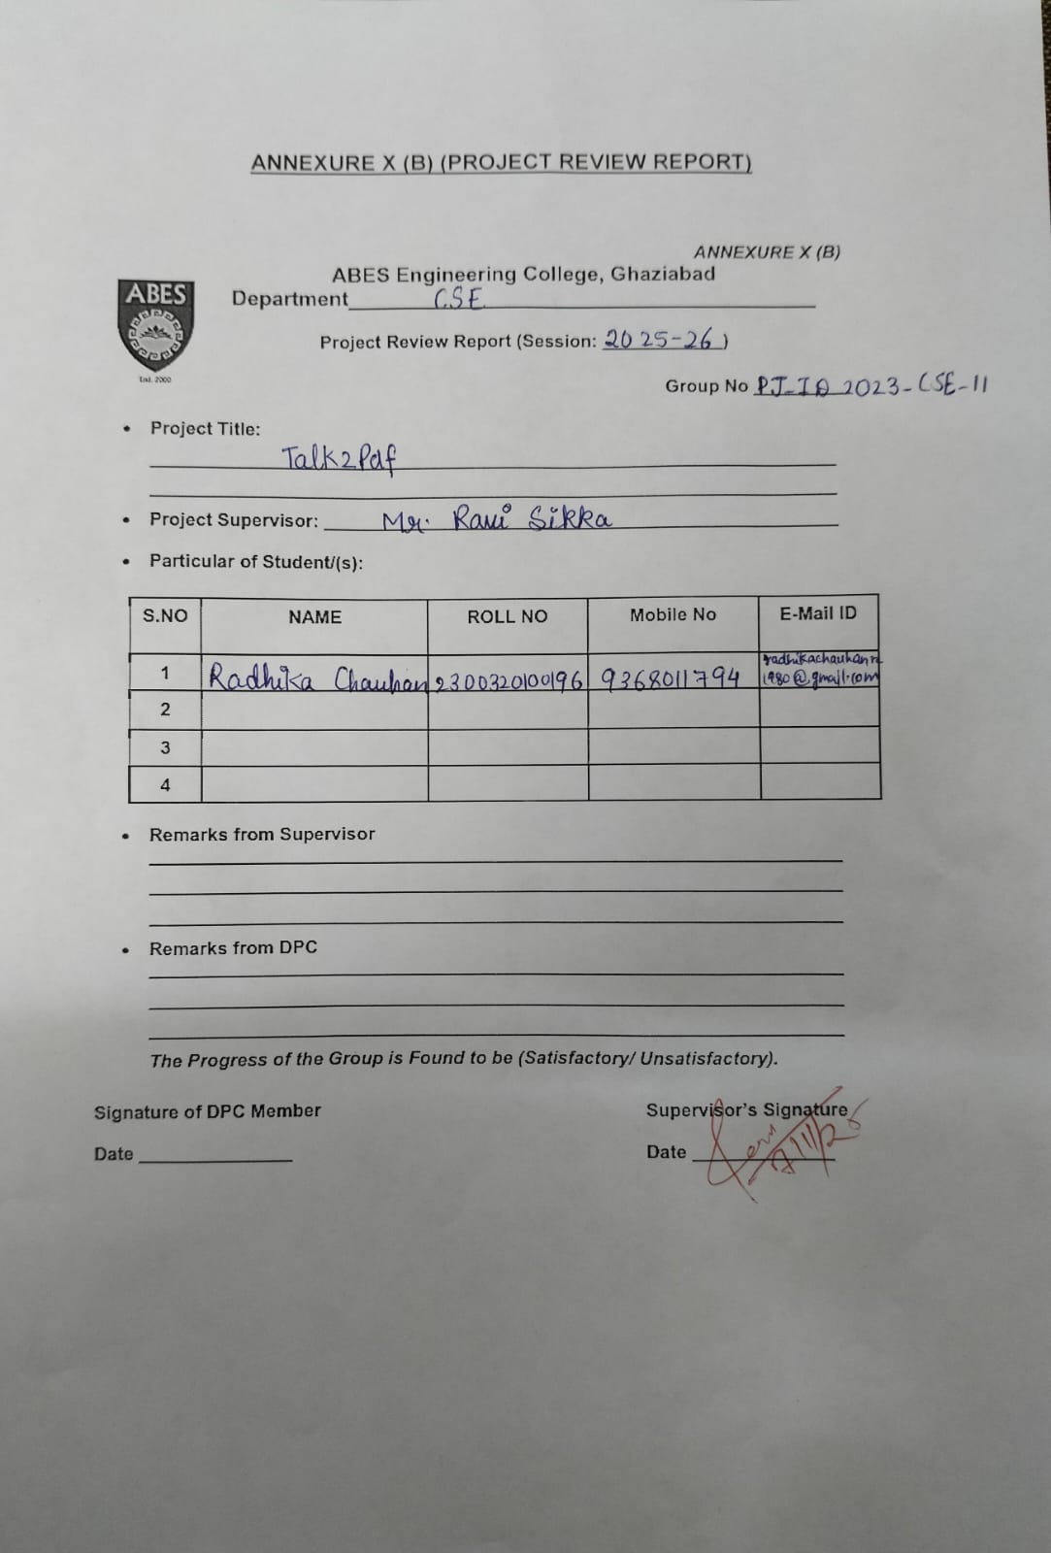
Annexure 10B

Slide 10
References
Adobe Acrobat AI Assistant – Official Website. Available: https://www.adobe.com/acrobat/ai.html
ChatGPT for PDF – OpenAI Documentation. Available: https://platform.openai.com/docs/guides/pdf
Google Cloud Vision API – Official Documentation. Available: https://cloud.google.com/vision/docs
IEEE Research Papers on Intelligent Document Processing Systems – IEEE Xplore. Available: https://ieeexplore.ieee.org/document/10421547

